Slide 1
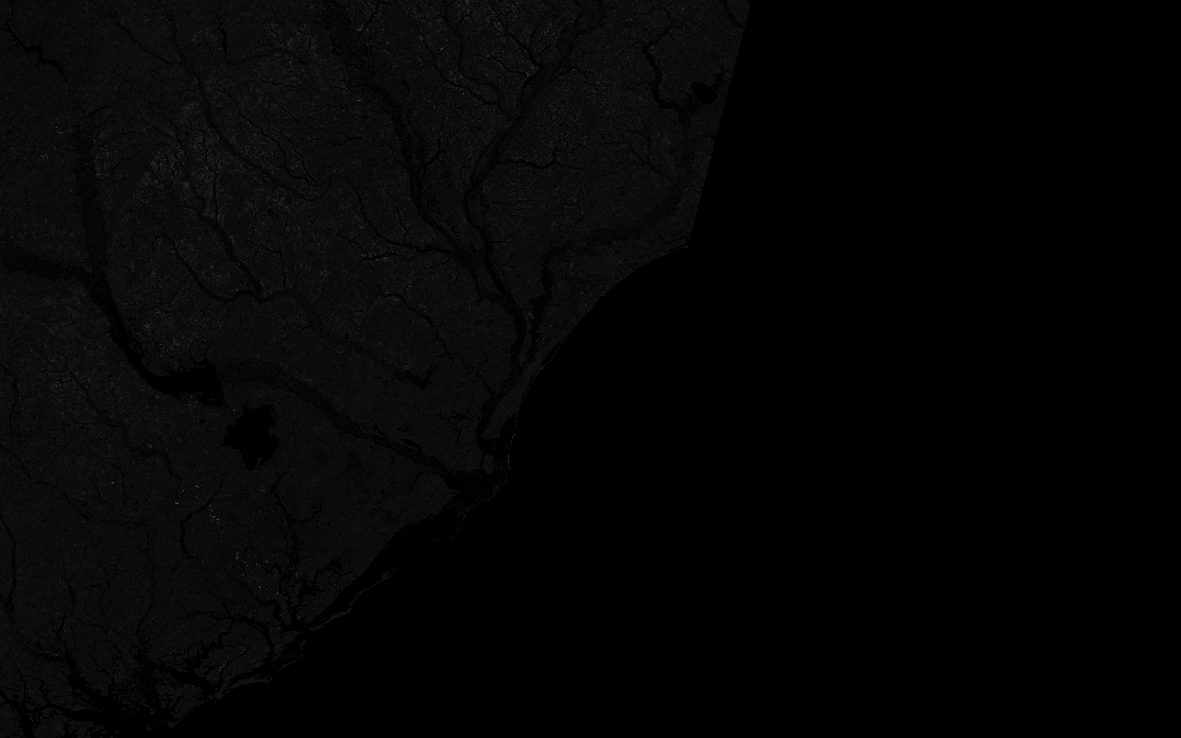
Project 2 Lakota Dolce

Slide 2
Blurring effects
Using imfilter() I applied different linear spatial filters to see different affects.
Filters I used were
Custom (very high SNR)
Gaussian (~13-15 SNR)
Laplacian (~4-6 SNR)
I also saw that the images were also made brighter by the filters being used for this
Image02
Image02 Custom Spatial linear filtering
Image04
Image04 Custom Spatial linear filtering
Image04 Lapalacian Spatial linear filtering
Image08
Image08 Custom Spatial linear filtering
Image08 Lapalacian Spatial linear filtering

Slide 3
Sharpening affects
Laplacian of Gaussian (LoG) uses convolution and correlation to sharpen the image instead of blurring it.
(~4 SNR)
Affects
Brightness
Sharpens the lines
Made the image spotty when zoomed in
Image02
Image02 Custom Spatial linear filtering
Image08 Gaussian linear filter
Image04 Laplacian of Gaussian linear filter
Image08 Laplacian of Gaussian linear filter
Image04 Custom Spatial linear filtering
Image12 Laplacian of Gaussian linear filter

Slide 4
Frequency filtering
Median Filtering at any level didn’t seem to help
Ideal Lowpass helped to take away the really brights
(SNR = 0)
Image08 Ideal low pass filter
Image08 Butterworth low pass filter
Image08 Gaussian low pass filter

Slide 5
Frequency filtering Cont.
High pass did the opposite making the rivers and darker water areas much more prominent
Sobel wasn’t helpful giving a topographical look
(SNR = 0)
Image08 Ideal high pass filter
Image08 Butterworth high pass filter
Image08 Gaussian high pass filter
Image08 Sobel filter

Slide 6
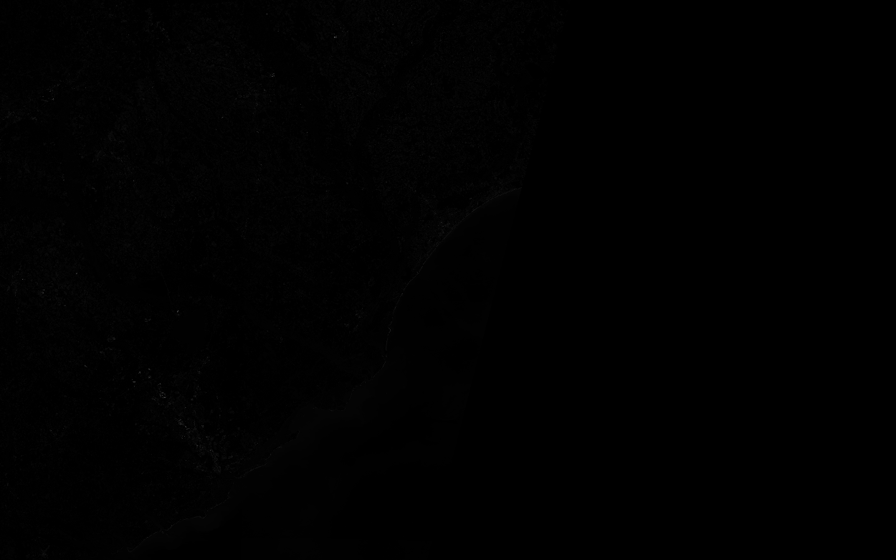
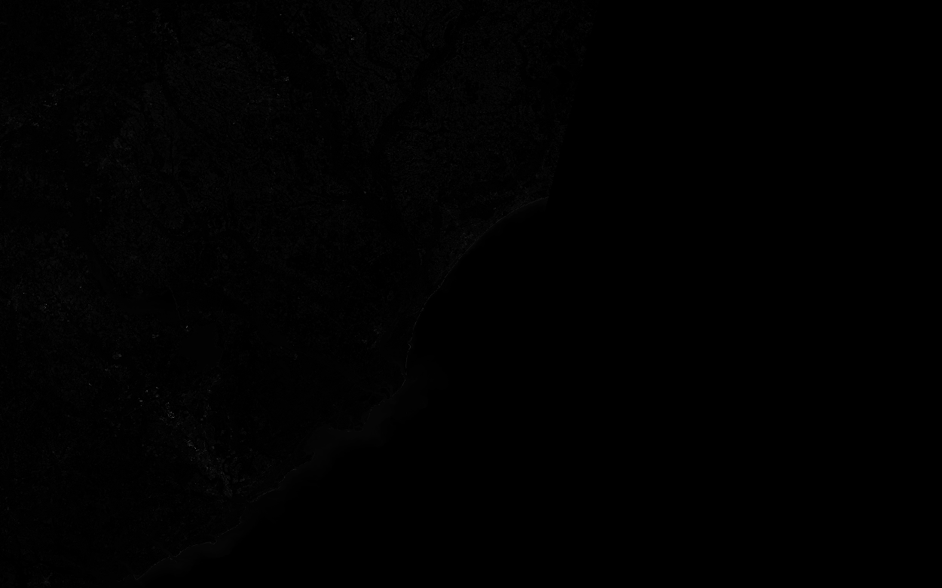
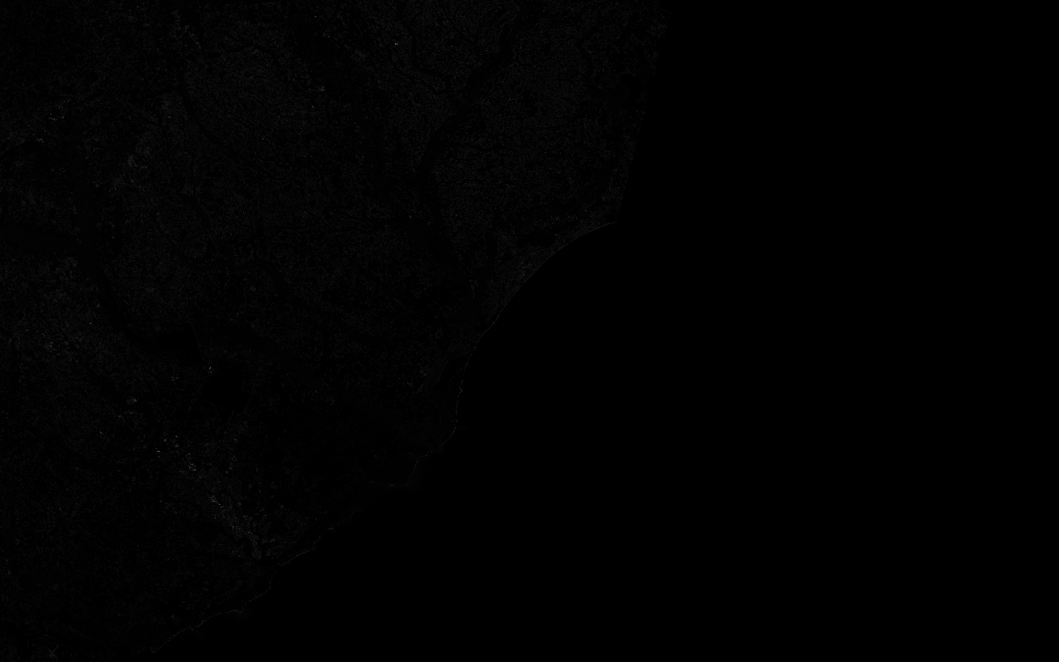
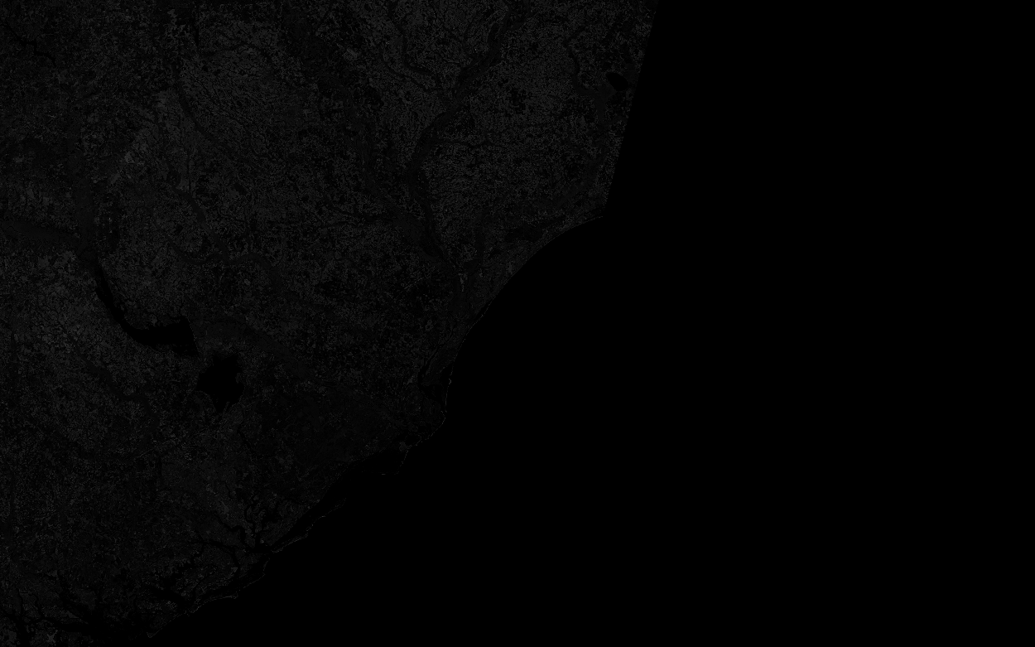
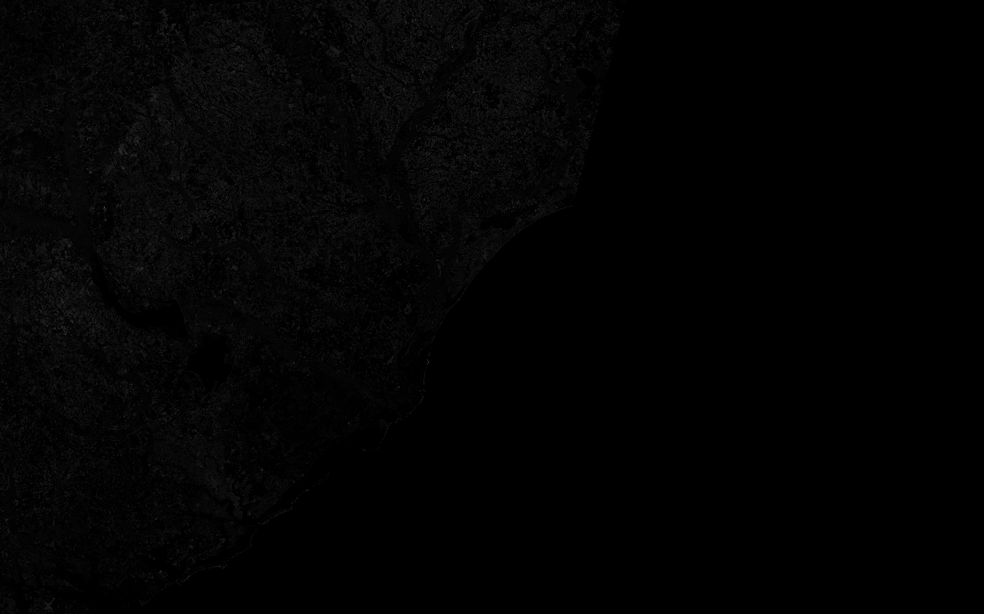
Conclusion
A mix of the high pass as well as the log transformation I felt was the best option
Image02 SNR = 1.79
Image03 SNR = 1.23
Image04 SNR = 0.91
Image08 SNR = 0.00
Image11 SNR = 0.00
Image12 SNR = 0.07
Image08 Sobel filter

